Slide 1
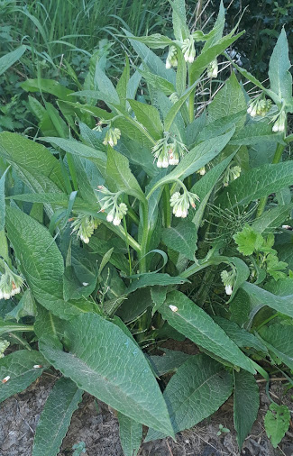
Green Tea for plants
Making your own fertilizers and growth promoters
Easy sustainable and it doesn’t usually involve inessential shopping.
There are lots of different ways Aerobic fermentations involves pumps and stirrers to aerate the mixture.
the easy Anaerobic way is just as good if made in small quantities and used promptly.
Here we will describe anaerobic compost tea.

Slide 2
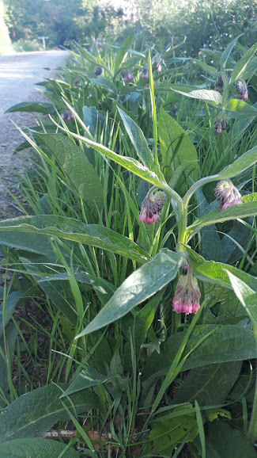
What can we use?
Some early growing plants are deep rooted and store minerals in the root over winter. So can produce big leaves early and fast. If we can extract the juice we can make an effective plant tonic.
Nettles in early spring can give a nitrogen boost. But are painful to collect.
Comfrey is less painful to collect and gives a Potassium and trace element boost as well as some nitrogen.

Slide 3
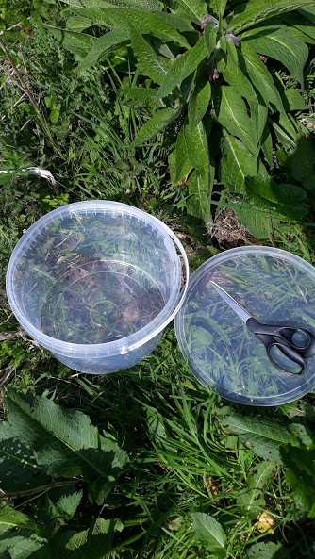
Think ahead about what would be useful
Bucket with a tight fitting lid
Scissors or knife
Gloves to protect from scratches.
Net bag (Like onion or kindling are sold in)
Weight to hold down the bag or sieve to separate the tea.
Rubber gloves to keep the mixture off your skin.
A small water butt with a tap is useful for drawing off some of the juice a bit at a time.

Slide 4
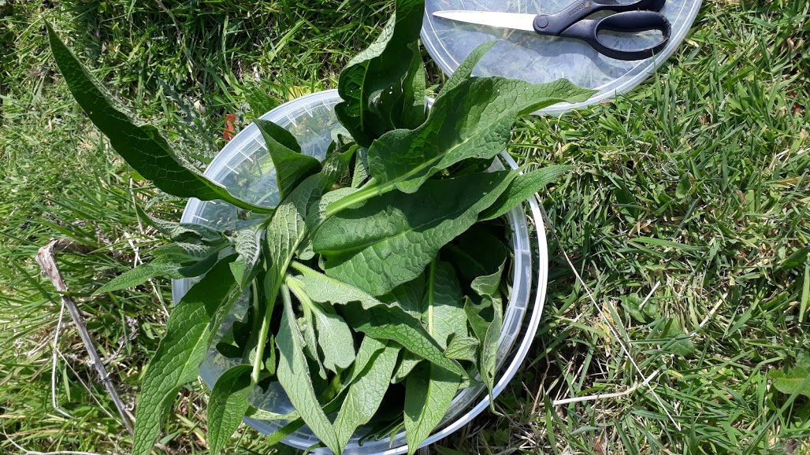
Find your Comfrey Symphytum officianalis
Identify your comfrey.
Found in waste land or verges which tend to be wet.
Big coarse hairy but not stinging leaves
Collect your plant leaves, cut with knife or scissors .
Then Chop it up and pack it down into your bucket.

Slide 5
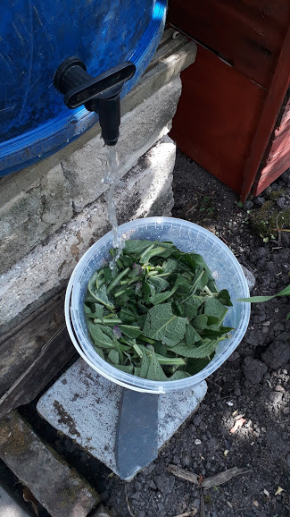
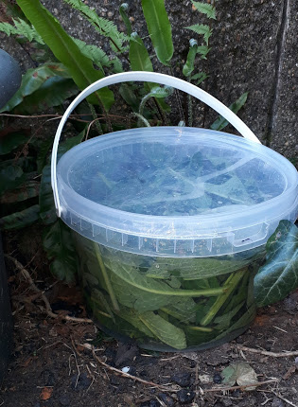
Fill your bucket with water and allow to brew
Put the top on and stand somewhere for 2-4 weeks.
Leave it somewhere away from the house or your neighbours because it can stink.

Slide 6
How should it be given to the plant?
The mixture should be brown and smell strongly.
It is best used at about 4 weeks, it will not improve after that.
Best diluted at 1:10 with water. It should look no darker than weak tea.
It is an excellent tonic but there might be bacteria which could cause stomach upsets so do not drink it and wash hand well after use.
Best watered on soil around the plant as traces left on salad leaves or fruit could be dangerous if not washed before use.

Slide 7
What else.
This is very similar to products sold as ‘Natural Plant Tonics’ but without the cost
We can also use other mixtures, but do not use any toxic plant like Docks or Arum lilies .
Next week Compost tea, Slug repellent, and Aphid control.

